Slide 1
Agency Prepayment: Turnover
June 2015

Slide 2
Outline
Introduction to Turnover
Description of Data
Empirical Observations and Comparisons
Description of Framework
Results
Spline Results
Going Forward
CLTV Consistency

Slide 3
Introduction to Turnover
Turnover Definition
Turnover is the measure of the rate at which borrowers sell their homes, thereby terminating their mortgage early. It does not include Refinances, Defaults or Curtailments.
We define ‘Base Turnover’ as any out-of-the-money (OTM) prepayment between 30 and 80 bp OTM. We also assume no defaults or curtailments.
Turnover Estimation
Turnover is not reported directly in any of our data sources
Turnover can be estimated by focusing on loans/pools that are slightly OTM with respect to a refinance incentive estimate
Avoid positive refinance incentive, as this will capture Refinancing borrowers
Avoid very negative refinance Incentive, as this creates a lock-in effect
Lock-In: Borrower does not want (or cannot) move because the rate reset will be too costly
For our ‘Base Turnover’ we focus on loan/pools with incentive between 30 and 80 bp OTM
Refinance Incentive
An accurate measure of refinance incentive is important for the analysis of turnover and will be more important in the Refinance module
We are using the Freddie Survey Rate with some adjustments for PMI and LLPA

Slide 4
Description of Turnover Data
Prepay Data
Pool Level
Turnover information available for Fannie and Freddie pools
~ 350K pools with data as far back as 1994
Loan Level
Turnover information available for Freddie loans
~ 3.7M loans with data as far back as 2006
Credit Data
Turnover information available for Fannie and Freddie loans
~ 18.2M loans with data as far back as 1999
Has indicators for Prepayment, and Default
Excellent coverage for FICO, DTI, CLTV (msa level), Occupancy, etc.

Slide 5
Description of Turnover Data: Turnover Definition
Prepay Data
Pool Level: Turnover Definition
Refinance Incentive between 30 and 80 bp out of the money
Current Balance / Scheduled Amortization Balance
Includes Turnover, Default and Curtailment (Full and Partial)
Credit Data
Loan Level: Default Definition
Refinance Incentive between 30 and 80 bp out of the money
Current Balance given Zero Balance Code = “Prepay”
Includes Turnover and Full Curtailment
Refinance Incentive
V1: Current Note - Survey Rate
V2: {Current Note Rate + PMI} – {Survey Rate + LLPA + New PMI}

Slide 6
Empirical Observations and Comparisons
Turnover Threshold for Refinance Incentive
Take the periods of high Cash-Out Refinance
This corresponds to a Median Ratio of New to Old Rate > 1
Pull the Survey Rate for that period and calculate the Old Rate from the ratio
Average the resulting differences in rate: ~42 bp Increase in Rate

Slide 7
Empirical Observations and Comparisons
Clear Refinance Incentive for > 50 bp
Clear Lock-In Effect < (-150 bp)
Turnover {-25, -75 bp}

Slide 8
Empirical Observations and Comparisons
Refinance Incentive Lag Estimation
No Lag Required for WAC Method
Needs a Lag between the Collateral and Survey Rate
Lag of 2 Months has the lowest volatility when compared with WAC method

Slide 9
Empirical Observations and Comparisons
Fannie and Freddie move closely, hence we use a combined series for robustness

Slide 10
Empirical Observations and Comparisons
Fannie and Freddie move closely, hence we use a combined series for robustness

Slide 11
Empirical Observations and Comparisons
Adjusted CPR for Prepay Pool data aligns well with Credit Loan data
Estimates for Default and Curtailment are removed to create the Adjusted Pool CPR
Prepay Pool data is more robust for higher wala

Slide 12
Empirical Observations and Comparisons
Same time period demonstrates comparable CPRs
- Pool ~1994-2015
- Loan ~2000-2014

Slide 13
Empirical Observations and Comparisons
Pools demonstrate significant Turnover CPR variability

Slide 14
Description of Framework
Overview
After removing defaults and curtailments, all out-of-the money prepayments correspond to turnover. The modeling strategy is to fit turnover for pools 30 bp to 80 bp OTM ("base turnover") and then layer in a lock-in effect.
Data
Query the pool and loan level data from IQ filtering by a slightly OTM incentive range
Aggregate the Turnover data by loan characteristics
Seasonality, WALA, HPA_1YR, Lock-In, CLTV
R Program
Read in the aggregated data
Determine by statistical methods which variable is most important
Calculate the balance weighted factor variables and SMM (single month mortality rate)
Estimate a spline from the empirical data
Repeat process for next most important variable
Output
Spline coefficients, which allow us to calculate an SMM given a set of loan characteristics

Slide 15
Results: Base Turnover CPR
The base turnover for the combined Fannie and Freddie pools is found by taking a weighted average of the prepayment rate for slightly OTM pools. This is then adjusted by subtracting model estimates for Curtailment and Default rates
Base Turnover is ~5.8 CPR using the FNMA and FHL pools
Base Turnover is ~6.1 CPR using the FNMA and FHL loans

Slide 16
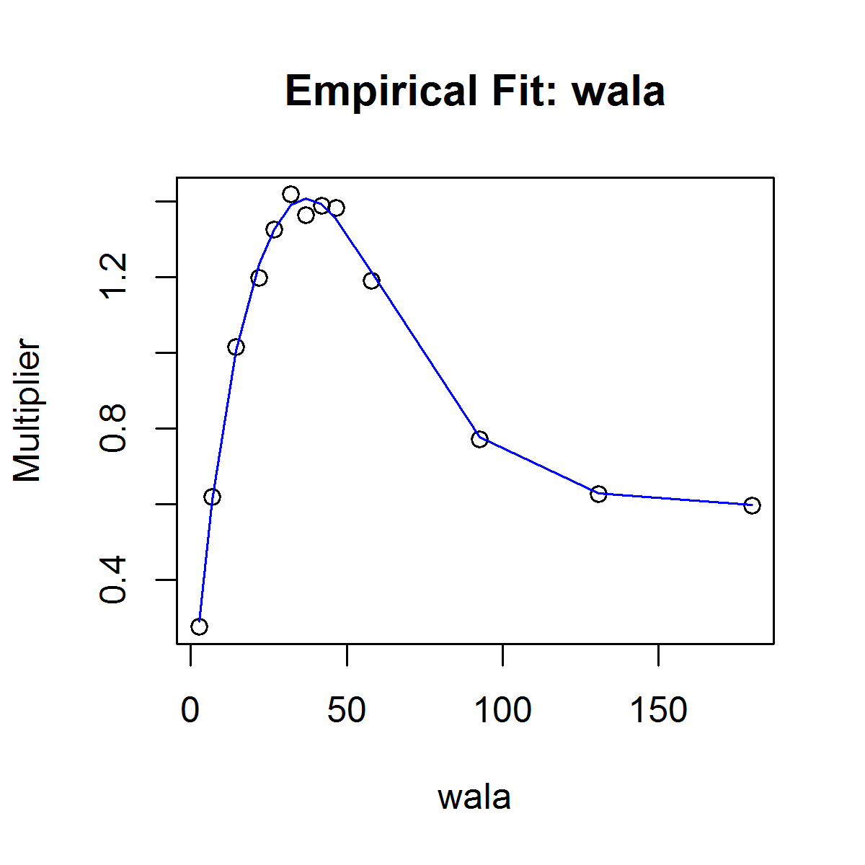
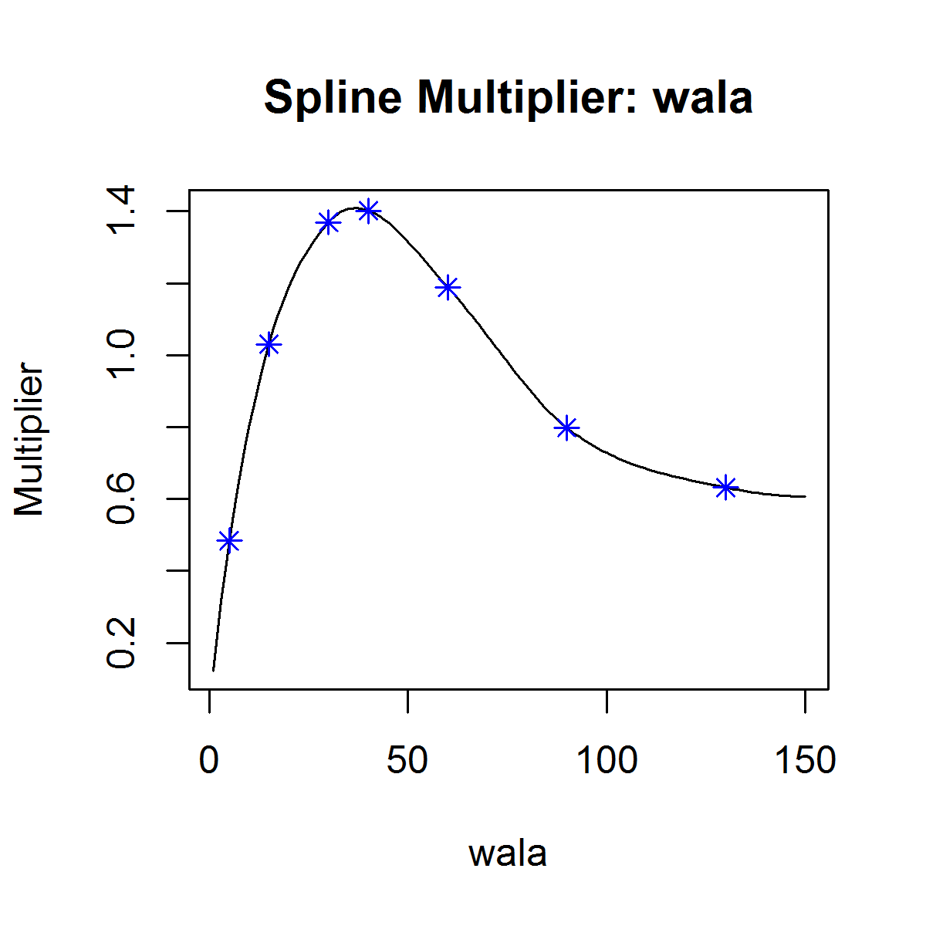
Results: WALA (Loan)

Slide 17
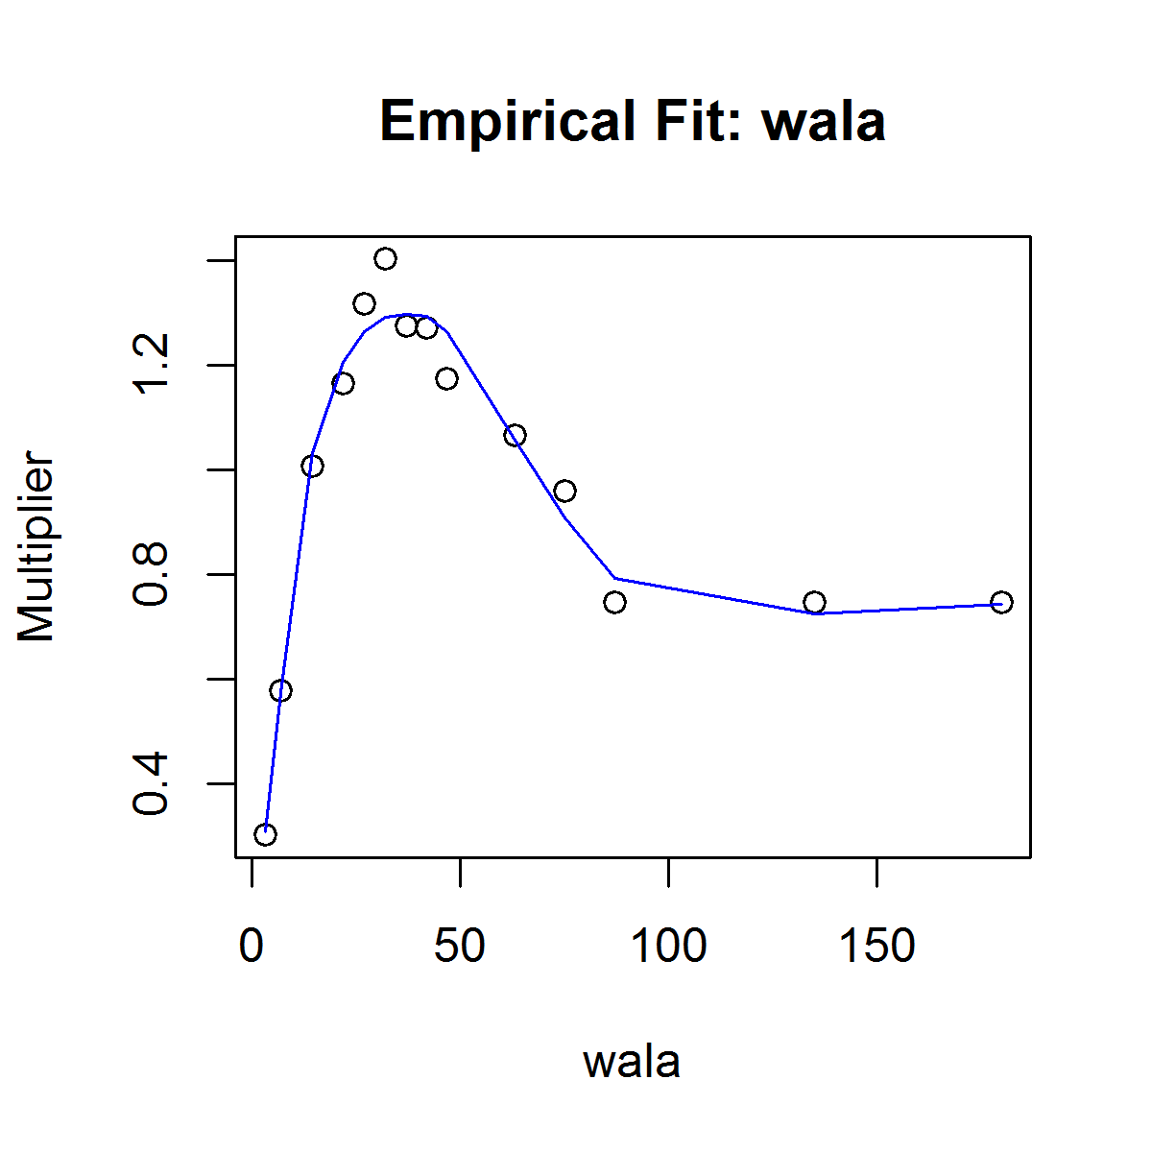
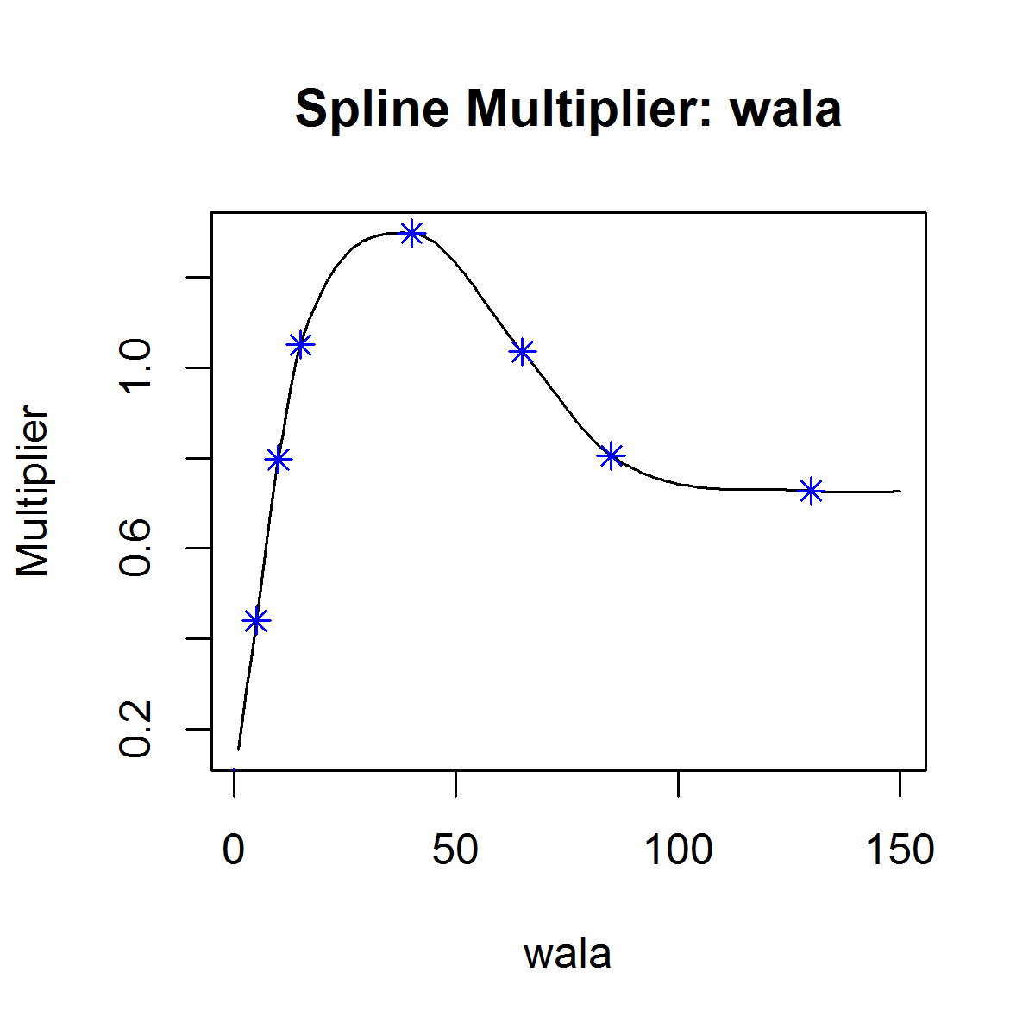
Results: WALA (Pool)

Slide 18
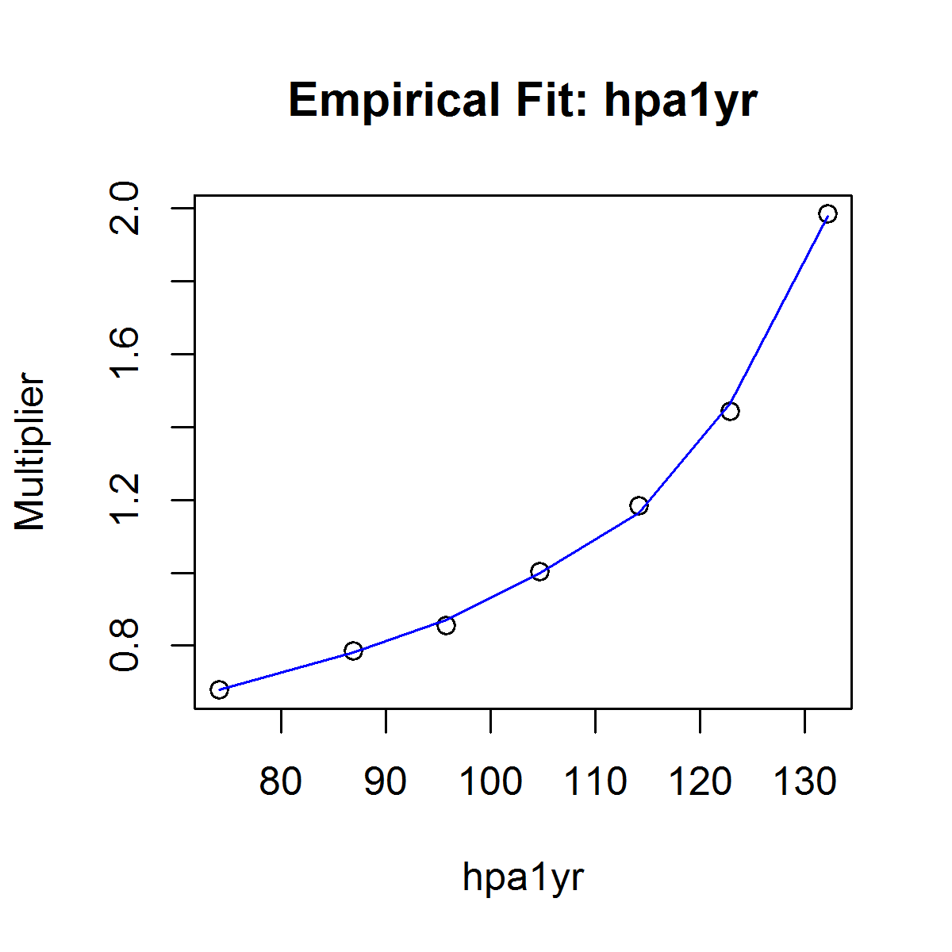
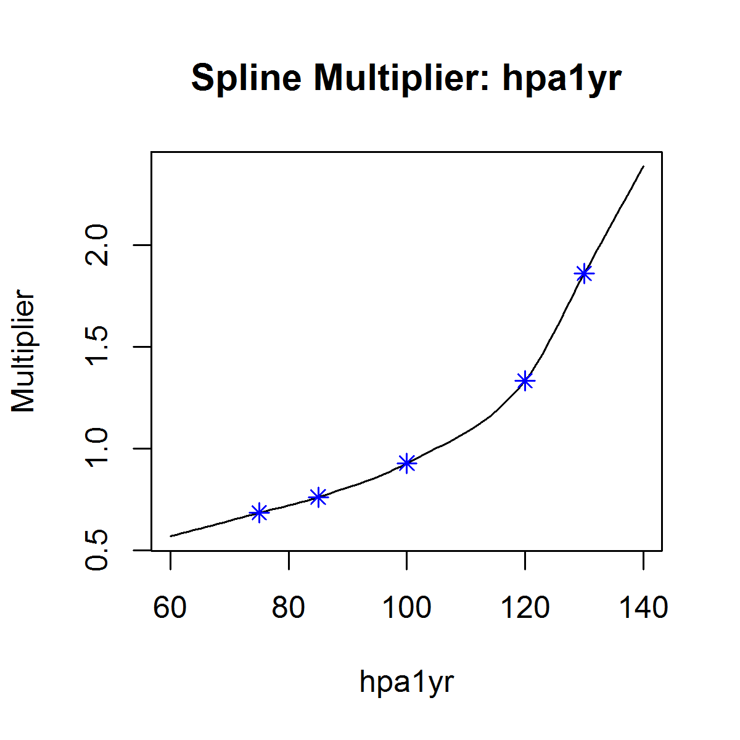
Results: HPI 1 YR (Loan)

Slide 19
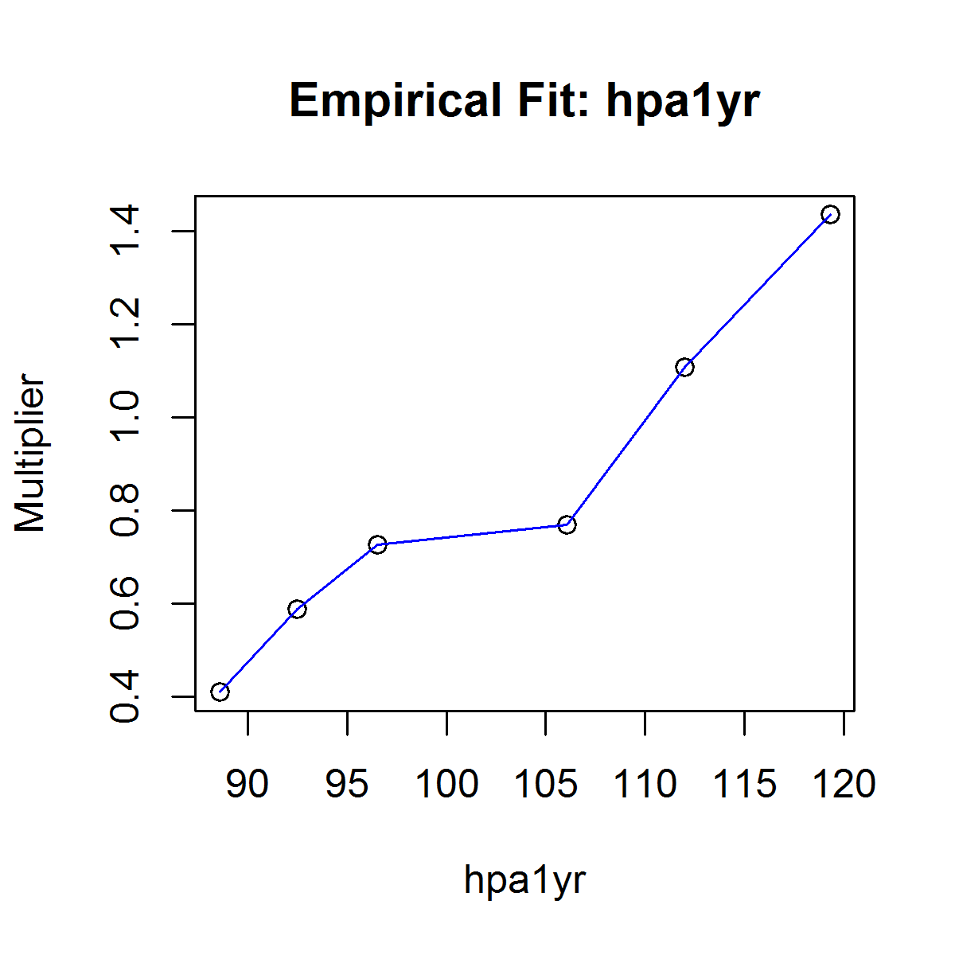
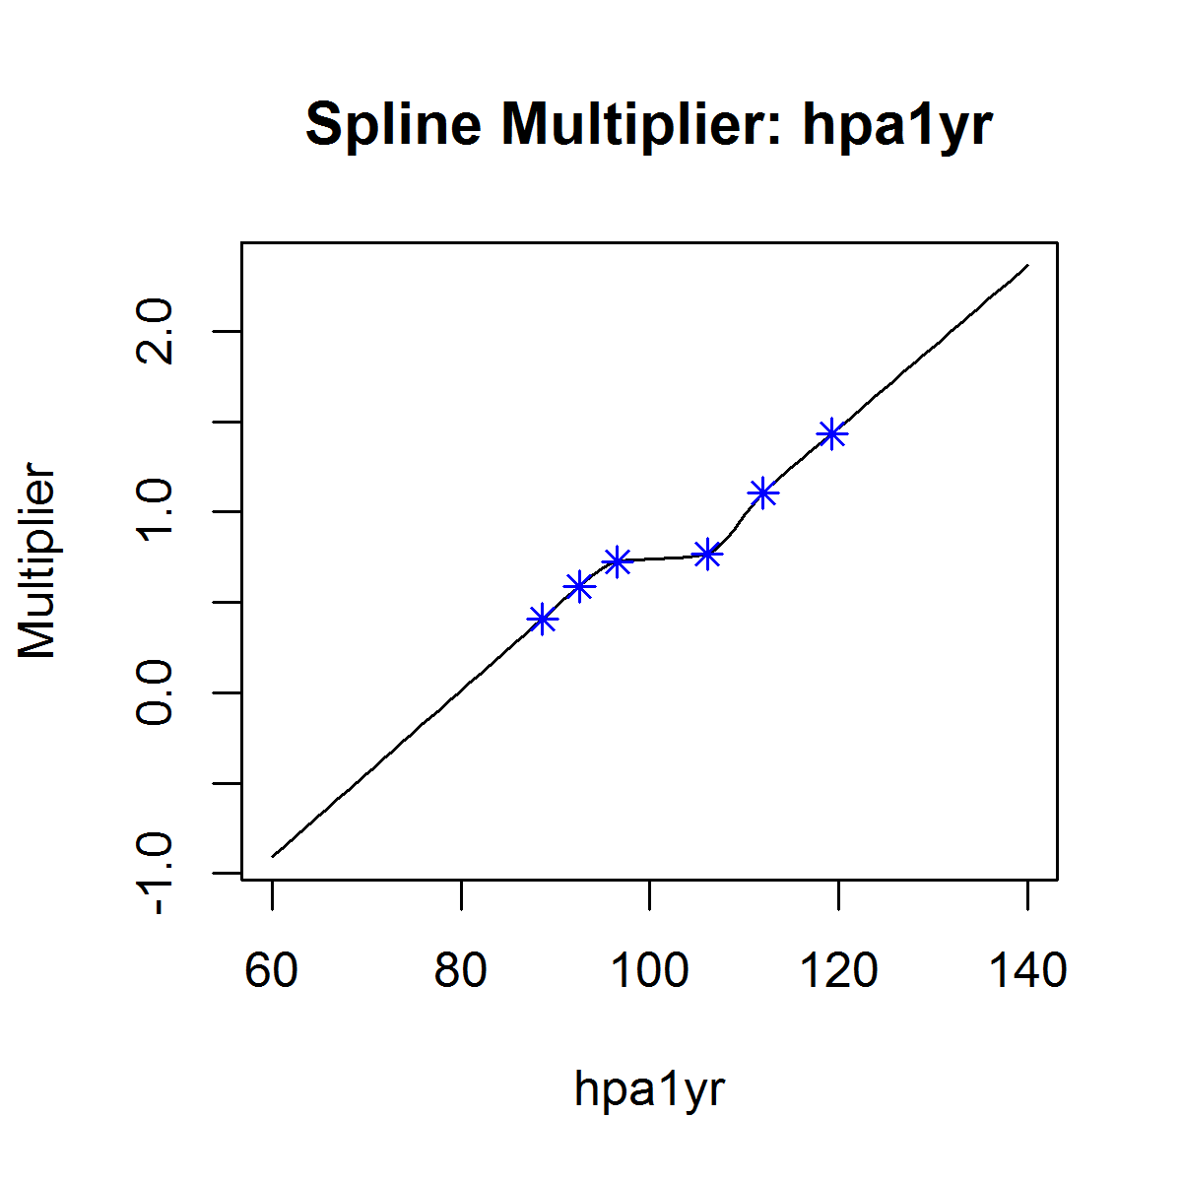


Results: HPI 2 YR (Pool)

Slide 20
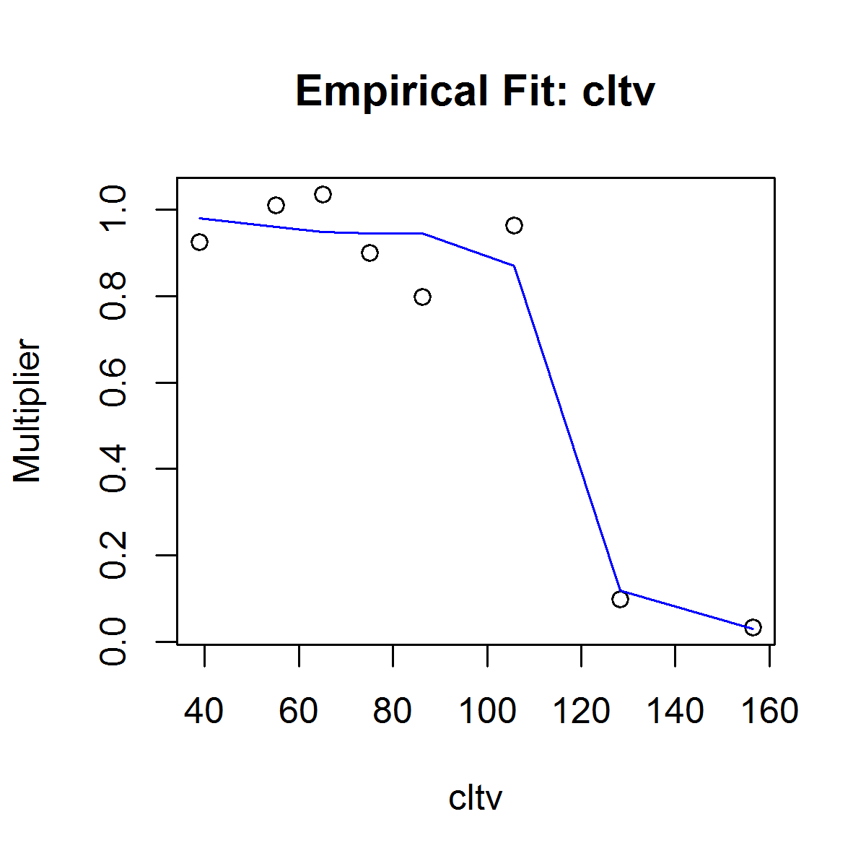
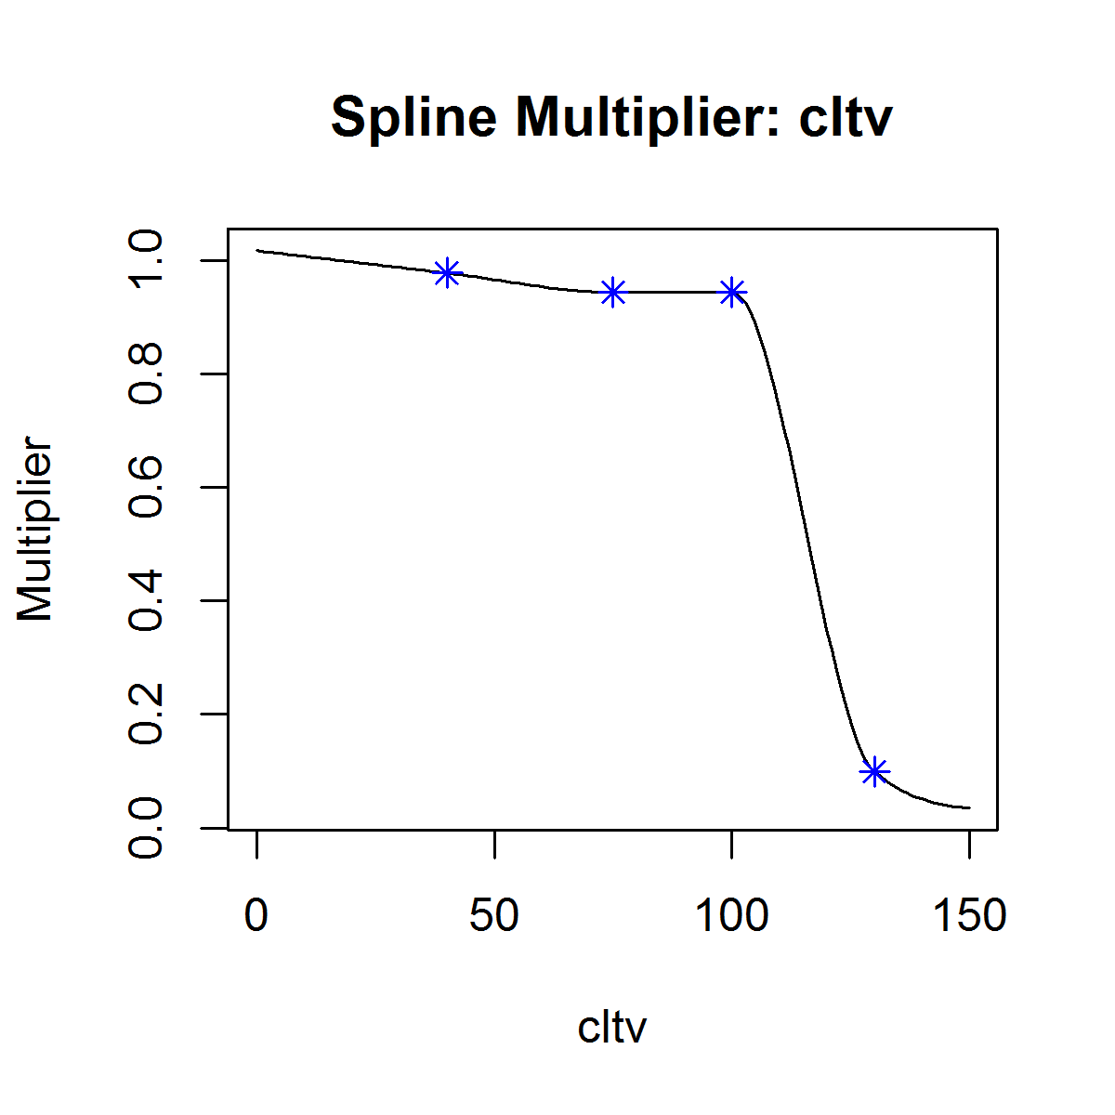
Results: CLTV (Loan)
Loan data demonstrates a steep drop in CPR as CLTV becomes >= 90

Slide 21
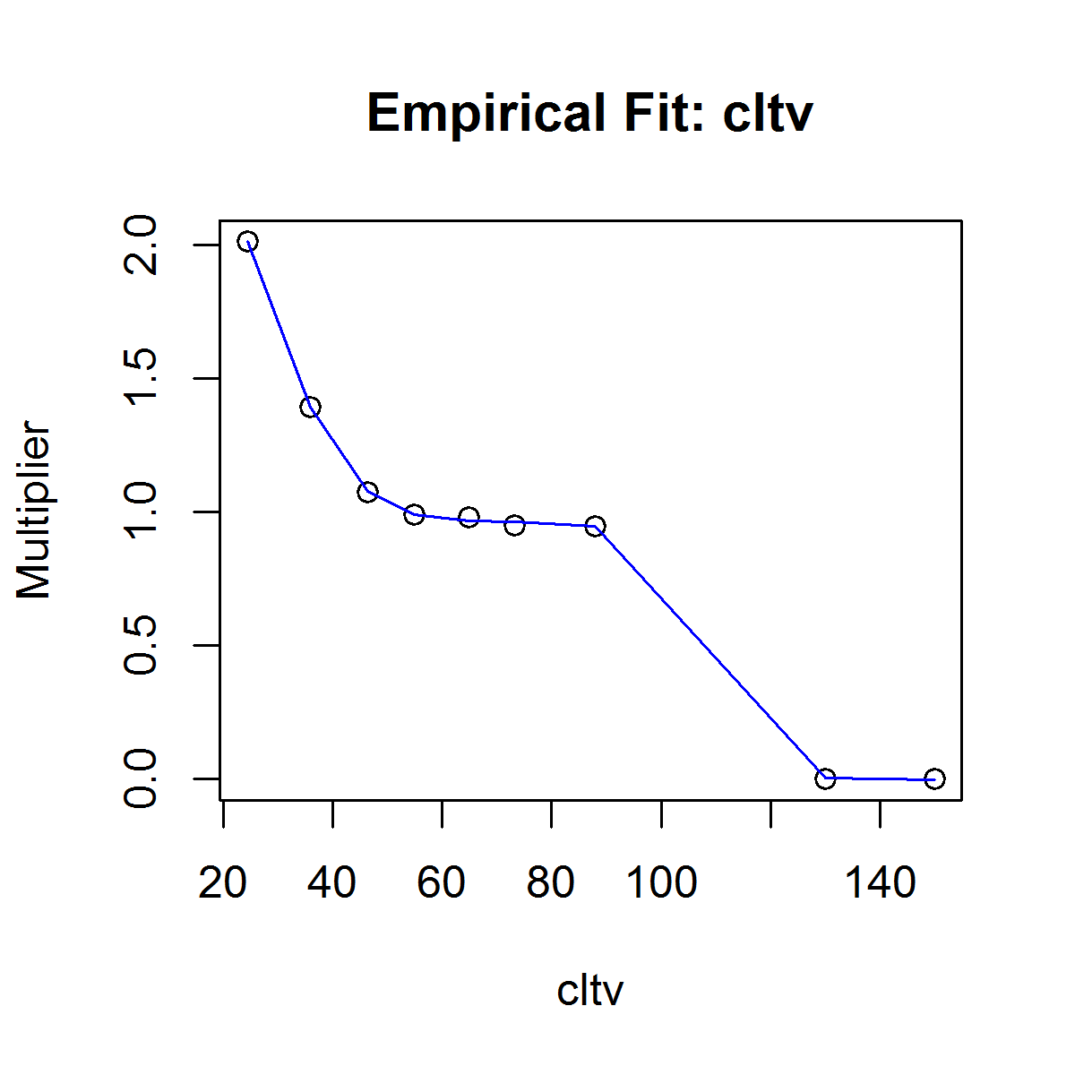
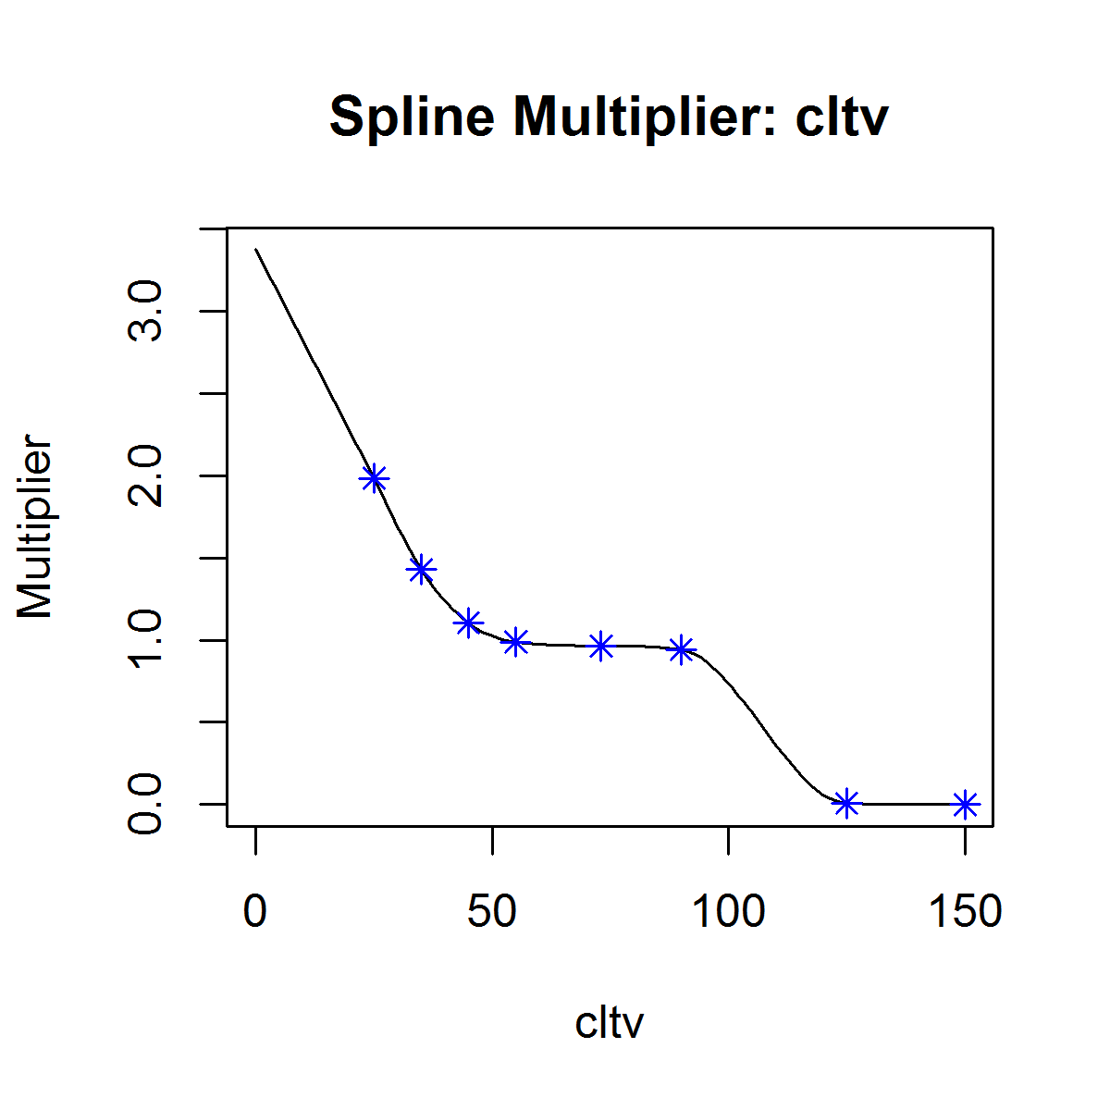
Results: CLTV (Pool)
Pool data demonstrates large rise in CPR as CLTV diminishes

Slide 22
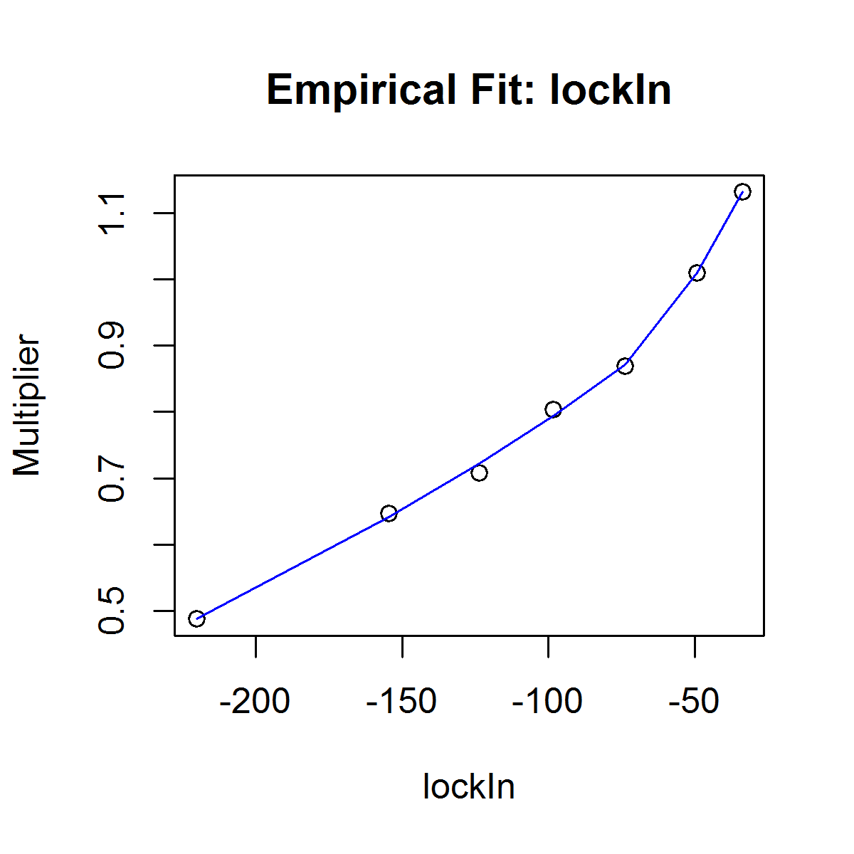
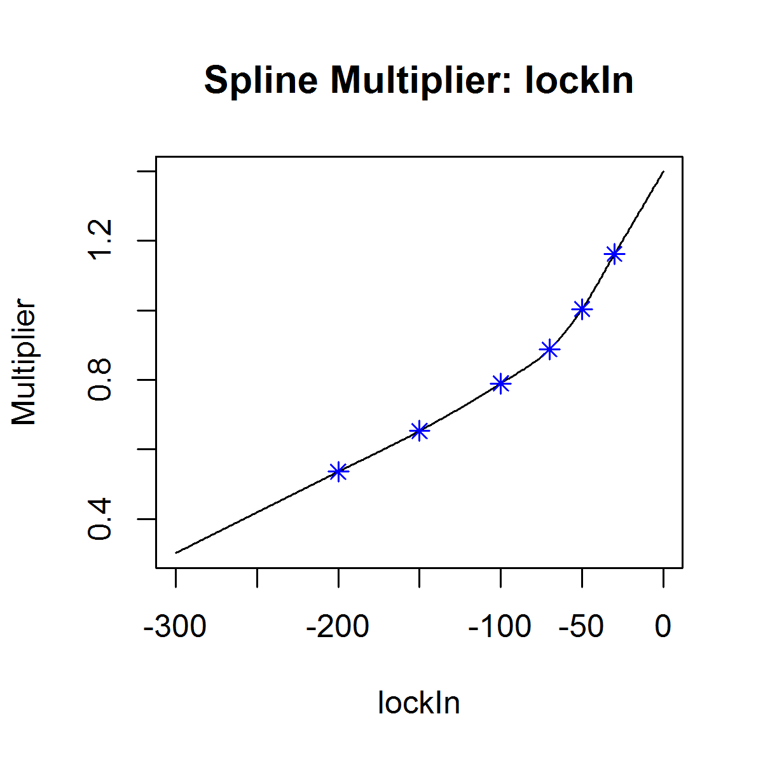
Results: Lock-In (Pool)

Slide 23
Going Forward: CLTV Consistency
There is an issue with the CLTV calculation from the credit data vs the prepay data
Prepay Pools calculate Current CLTV from “Purchase Only” HPI time series
Credit Data calculates Current CLTV from “All Transactions” HPI time series
Results are not consistent
TODO:
Create another CLTV in the credit tables with data from the Purchase Only HPI time series
Redo the analysis to use the compatible CLTV

